Slide 1
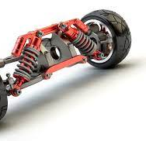
AUTOMOTIVE STRCTURES AND DESIGN
SUSPENSION SYSTEM
BY
GUNDA VENKATA SAI JAI HARSHA
190C2050003

Slide 2
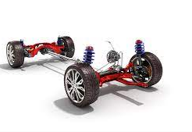
Component
Suspension system

Slide 3
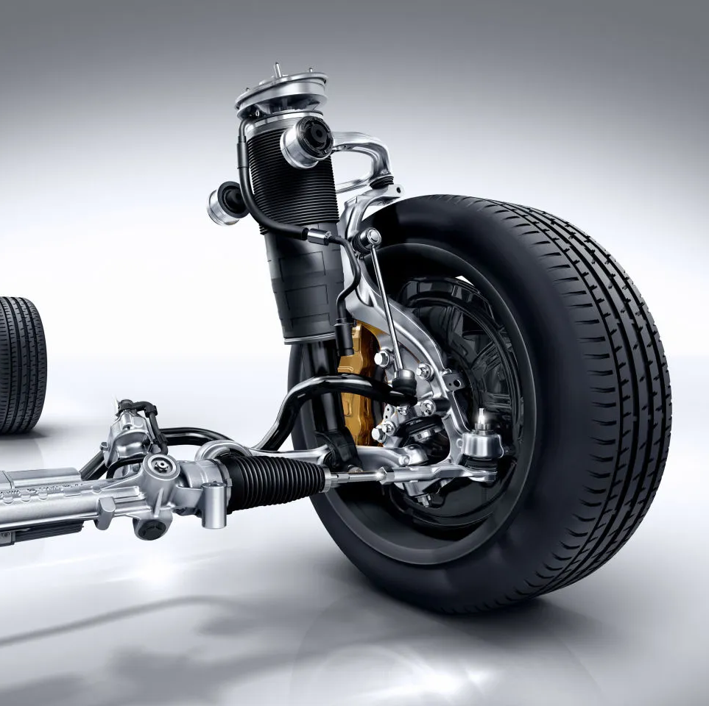
What Is Suspension ?
Suspension in the automotive industry is a system of shocks, springs, uprights and arms that together keep a vehicle suspended above ground on its wheels.
Serve a dual purpose – contributing to the car's handling and braking.
Protects the vehicle itself and any cargo or luggage from damage and wear

Slide 4
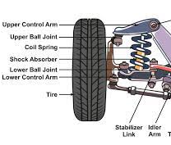
Components
A suspension system is usually made up of the following components:
Spring – This can come in many forms
Damper– There are many variations to choose from
Suspension Arms – The positioning and mounting of the arms determine the geometry of the vehicle.
Upright or Hub – This part mounts the wheel and brakes to the suspension and is the point that all the suspension arms mount to.
Wheel – The wheel bolts to the upright and connects the Tyre to the hub. They come in various diameters, offsets and PCDs (the number of bolt holes and the distance between their center's)
Tyre – The Tyre is the only point of contact with the ground and is responsible for the grip of the vehicle.

Slide 5
Functions
A suspension system in an automobile serves the following functions:
Shock forces are reduced as much as possible
Maintain the proper ride height of your car
Maintain proper alignment of the wheels
Serve as weight support for the vehicle
Maintain tire contact with the road
Controls the vehicle’s travel direction.
To eliminate transmission to car component road shocks.
To maintain a solid grip on the road while driving, cornering, or braking.
To maintain the correct steering geometry.
To achieve a specific body structure and height.
Torque and braking reflexes must be resisted.
Maintaining vehicle stability while traveling over uneven terrain or turning in order to reduce the tendency for rolling, pitching, or vertical movement.
To protect passengers from road shocks and give a comfortable ride.
To reduce the strains caused by road shocks on the motor vehicle’s mechanism and offer a cushioning effect.
While traveling over tough, uneven terrain, keep the body absolutely level. The up and down movements of the wheels should be proportional to the movement of the body.
To protect the vehicle’s structure from stress loading and vibration caused by road surface irregularities while maintaining its stability.
To achieve the necessary height for body structure.
To retain the right geometrical relationship between the body and the wheels, the body must be supported on the axles.

Slide 6
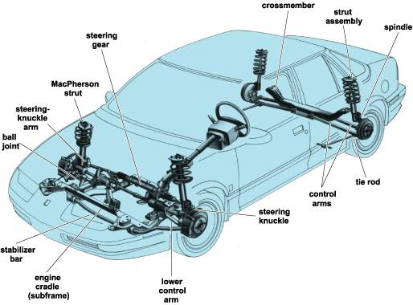
Suspension system - layout

Slide 7
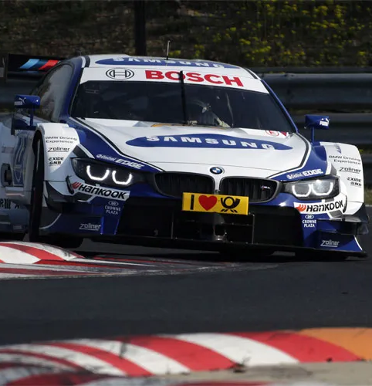
The Purpose of Suspension
Suspension within the motorsport and automobile industry serves two main purposes, both of which are fundamental to make a car or vehicle travel as fast as possible, particularly through corners.
The first purpose of suspension is to always keep the tyre in contact with the ground and to overcome and absorb any disturbances from uneven ground, cornering forces and acceleration/braking forces.
Keeping the Tyre in contact with the ground always means that the maximum amount of grip is available, allowing the vehicle to corner and accelerate faster and brake harder, resulting in a much faster vehicle.
The other main purpose of suspension is to deliver accurate feedback to the driver so that they can feel exactly how the vehicle is turning and responding to their inputs.
This feedback gives the driver confidence in their vehicle and allows them to push harder and drive even faster to the very limits of grip, which is the fastest possible point the vehicle can travel.
The feedback also makes the limit of grip clear and smooth, making it a safer line to ride for a good driver.

Slide 8
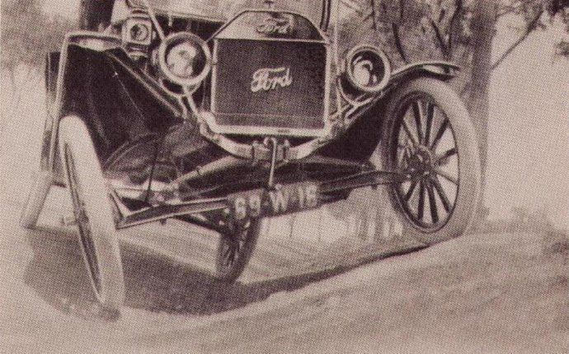
Automotive Springs — the Backstory
The modern automobile suspension system was developed in 1904. Automobile suspension was quickly upgraded in 1906 when front coil springs were mounted on a flexible, hickory axle that dampened spring bounce.
Leaf springs were first used on carriages. In 1804, the stackable leaf spring was invented and used primarily in rear suspension systems.
Coil springs were first invented in 1763 and were experimented with further, but car makers stood behind leaf springs because leaf springs were less costly and could support varying weights by simply changing the roundness of the leaf spring.
In 1908, Henry Ford used leaf springs mounted on each axel as opposed to having one mounted to each wheel. Ford later discovered he could gain more strength by using vanadium steel in the Model T.
Coil spring were not used in the front suspension again until 1934 when all the major auto makers reintroduced coil springs into the front suspension, this time with each wheel having its own, independent spring. Around the same time, cars also begin to use shock absorbers and low-pressure tires to further improve suspension systems and lessening spring bounce.
Rear-end coil springs were first introduced by Buick in 1938. The larger cars generally had leaf springs, while smaller cars had coil springs.
Even today, car suspension systems are being constantly improved and the leaf and coil spring still plays a vital role in the automobile suspension system

Slide 9
Types of suspension
Total 4 types

Slide 10
Different suspension systems
Conventional suspension system
Independent suspension system
Air suspension system
Hydro elastic suspension system

Slide 11
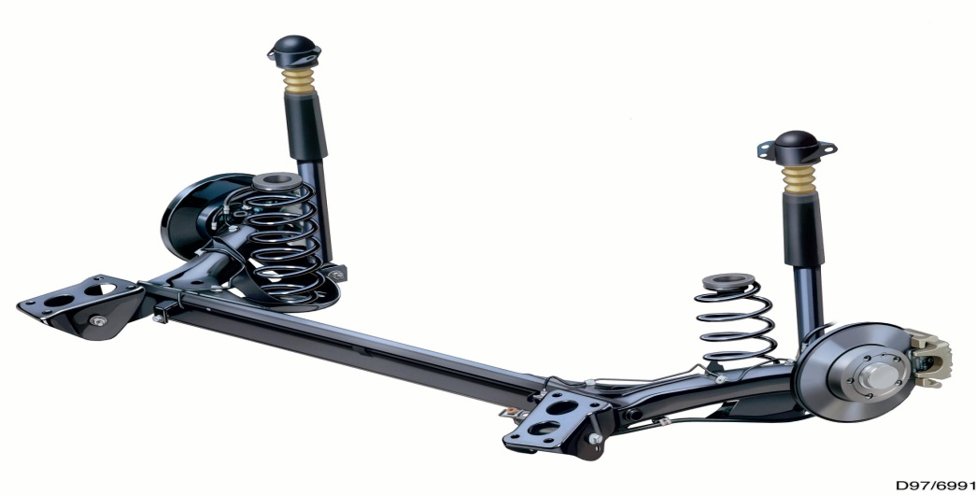
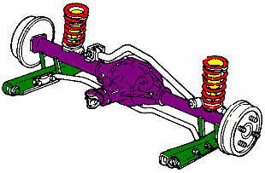
Conventional suspension system
Two wheels are mounted on either side of the rigid axle
When one wheel encounters the bump, both the wheel do not execute parallel up and down motion
So, it gives rise to gyroscopic effect and wheel wobble
Rear driving wheels mounted on live axle suspended by laminated leaf springs and shock absorbers

Slide 12
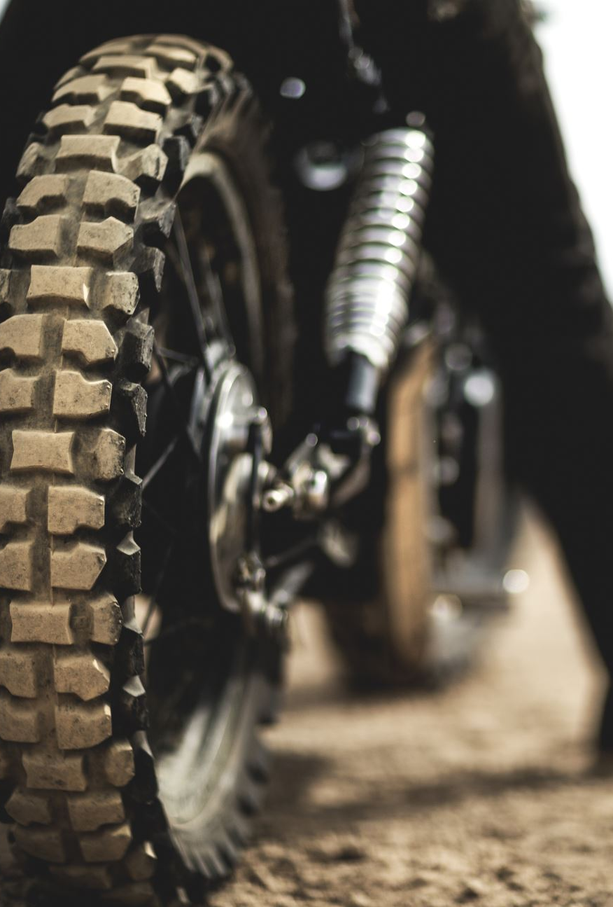
Independent suspension system
Both the front and the rear wheel are utilized
Design incorporated in the front wheels
One wheel goes down ,the other wheel does not have much effect
Basic classification of the design
MacPherson Strut
Double Wishbone
Multi link

Slide 13
MACPHERSON STRUT
The most widely used front suspension system in cars
Comprises of a strut-type spring and shock absorber combo, which pivots on a ball joint on the single, lower arm.
The steering gear is either connected directly to the lower shock absorber housing, or to an arm from the front or back of the spindle (in this case)
When you steer, it physically twists the strut and shock absorber housing (and consequently the spring) to turn the wheel

Slide 14
DOUBLE WISHBONE SUSPENSION
Type of double-A or double wishbone suspension.
Wheel spindles are supported by an upper and lower 'A' shaped arm.
The lower arm carries most of the load.
If you look head-on at this type of system, parallelogram system that allows the spindles to travel vertically up and down.
This side-to-side motion is known as scrub

Slide 15
Multi-link suspension
It's currently being used in the Audi A8 and A4 amongst other cars.
The basic principle of it is the same, but instead of solid upper and lower wishbones, each 'arm' of the wishbone is a separate item.
These are joined at the top and bottom of the spindle thus forming the wishbone shape.
The super-weird thing about this is that as the spindle turns for steering, it alters the geometry of the suspension by torquing all four suspension arms.
Spring is separate from the schock absorber.

Slide 16
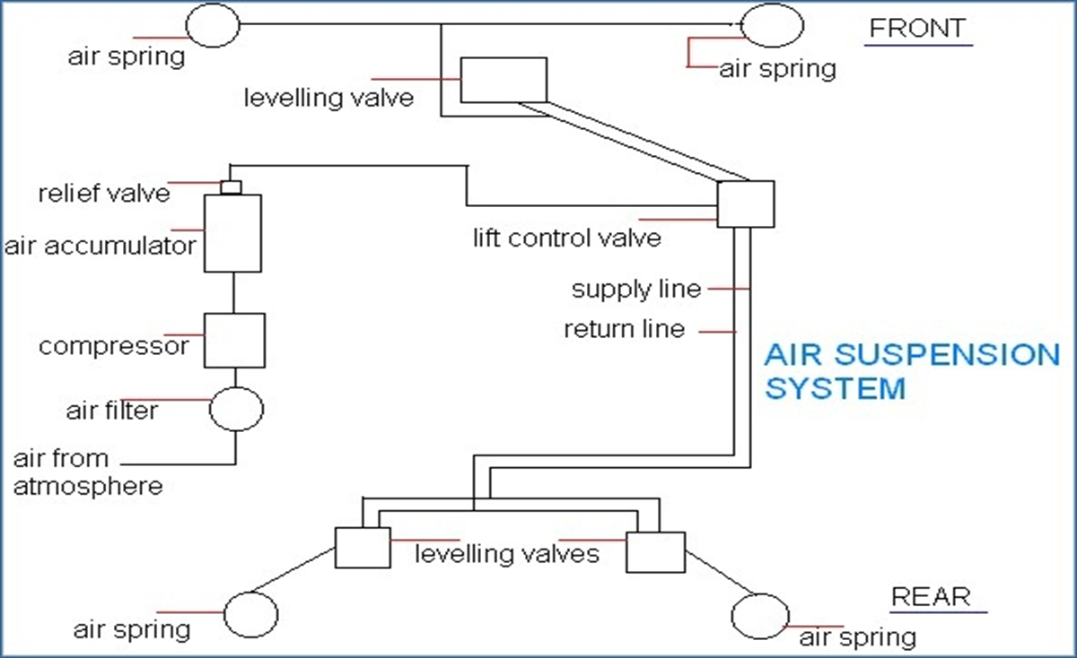
Air suspension
Comprises of compressor , suppling air to air tank
Pressure maintained – 5.6 to 7 kg/sq.m
Air bags – on each wheel
As load applied , air bags compressed actuating the levelling valve .
Air from the tank fills the compressrd air bag & hence raise the level of the frame.
Air from air bag gets released as load on chassis decreases

Slide 17
Hydro elastic Suspension
a system where the front and rear suspension systems were connected together in order to better level the car when driving.
The front and rear suspension units have Hydro elastic displacers, one per side.
These are interconnected by a small-bore pipe. Each displacer incorporates a rubber spring
Damping of the system is achieved by rubber valves.

Slide 18
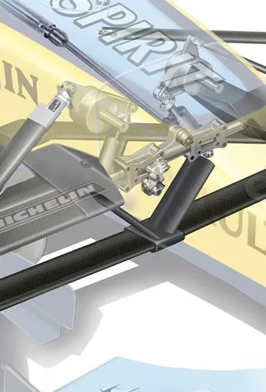
What Is Suspension Geometry?
Suspension geometry is the positioning and angular movement of the suspension arms and the effect that they have upon the movement of the wheel and Tyre.
It is caused by the different components of the suspension system all moving in their designed paths, which together generate changes in direction and multiple forces on the wheel and Tyre, making the steering and suspension operate in particular ways.
The main purpose of suspension geometry is to work the tyre and ensure that the maximum amount of grip is being used from the tyre during all conditions including cornering, acceleration, braking and uneven ground conditions.
The behavior and movement of all the combined areas of suspension geometry result in a car that handles well and delivers positive driver feedback, resulting in a fast competent vehicle.

Slide 19
Design
The suspension design is crucial in the development of vehicle behavior to optimize vehicle performance, handling and comfort. There are a multitude of possible adjustments depending on the vehicle (comfort, sportiness, etc.). These settings play a important role in passengers' safety in all phases of driving (braking, cornering, traction).
We use lotus software to design the suspension.
Depending on the various parameters such as driver comfort, required ground clearance, and rolling tendency of vehicle we selected double wishbone suspension system at front and rear.

Slide 20
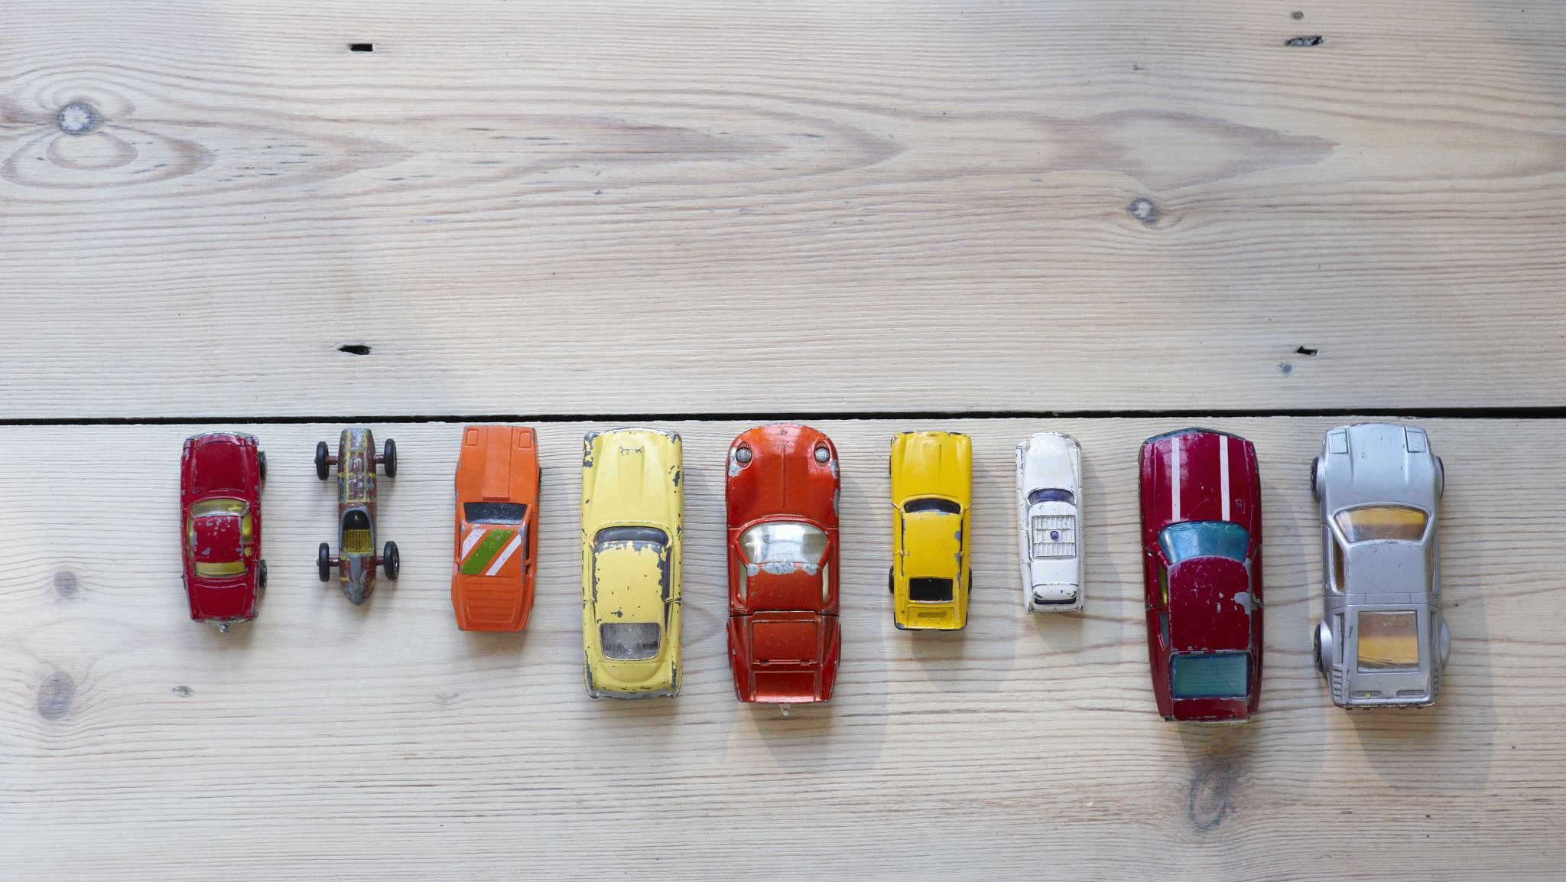
Present vehicles

Slide 21
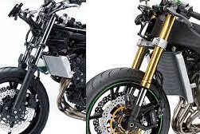
Motorcycle
There are two types of motorcycle rear suspensions, one is Single Suspension (Mono Shock) and the other one is Double Suspension (Dual Shock). There are also custom-built rear shock absorbers out in the market which are built as per the specifications of the bike, riding style and weight of the bike.

Slide 22
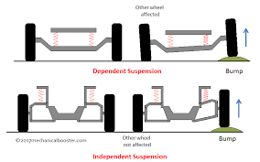
Car

Slide 23
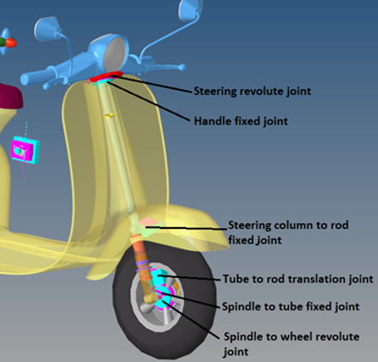
Scooty
Spring, hydraulic, telescopic, mono or dual shock suspensions are a few to name. The Indian market offers a vast range of scooters, each with a different combination of front and rear suspensions. Ultimately, it is the choice of the rider as to which suspension suits the best.

Slide 24
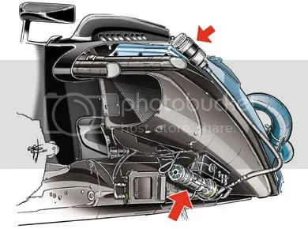
Innovations
In an ongoing endeavor to control ride height several teams have come up with a passive system which meets the FIA’s regulations: Namely the Front and Rear Inter-Connected (FRIC) system.
Although details are closely guarded it is believed the FRIC system, with the hydraulic actuator (lower arrow) housed in the sidepod, displaces hydraulic fluid (the upper red arrow shows the fluid reservoir) from one end of the car to the other in order to maintain a constant ride height and aerodynamic balance.
Ride height is not the only dynamic that influences the performance of modern race cars: The quest to dampen out vibrations and harmonics set up by the movement of the wheel and the spring’s reaction to this is also ongoing.
Suspension system development is not only about improving ride and handling. With legislation forcing reductions in emissions and fuel consumption vehicles are becoming lighter, and although this has many benefits, the reduction in sprung mass means that to maintain acceptable levels of performance unsprung mass also needs to be trimmed.

Slide 25
Suspension to and FRO motion can be used as energy for different purposes. Attach a motor with suspension damper and conserve the energy for lightning the small equipment's in vehicle.
We can also add the technology which can change the ride height, caster, camber of vehicle.
We can create a circuit which can detect the breakage or failure in suspension system.

Slide 26

THANK YOU SIR

